Slide 1
Circular Economy
& the Construction
Sector

Slide 2
Workshop 3a – Innovation and the
Circular Economy
This Workshop is part of a group of three short workshops which highlight three areas of innovation in the construction sector that offers the additional benefit of making the sector more circular. The three areas are:
Modular Design and Build
Building Information Management
Refurbishment and Building Layers
Circular Economy
and the Construction Sector
Notes:
This workshop is brings together 3 new areas of innovation for the construction sector that are relevant to the implementation of a circular economy. These concepts are highly innovative and are likely to bring about significant change to the construction sector not just in relation to waste management and resource efficiency but also in the broader efficiency and delivery of construction projects.
They are modular design and build building information management or BIM and
Scope for greater refurbishment and viewing buildings as layers with different time frames.
This workshop focusses on Modular Design and Build and the scope for prefabrication off site.

Slide 3
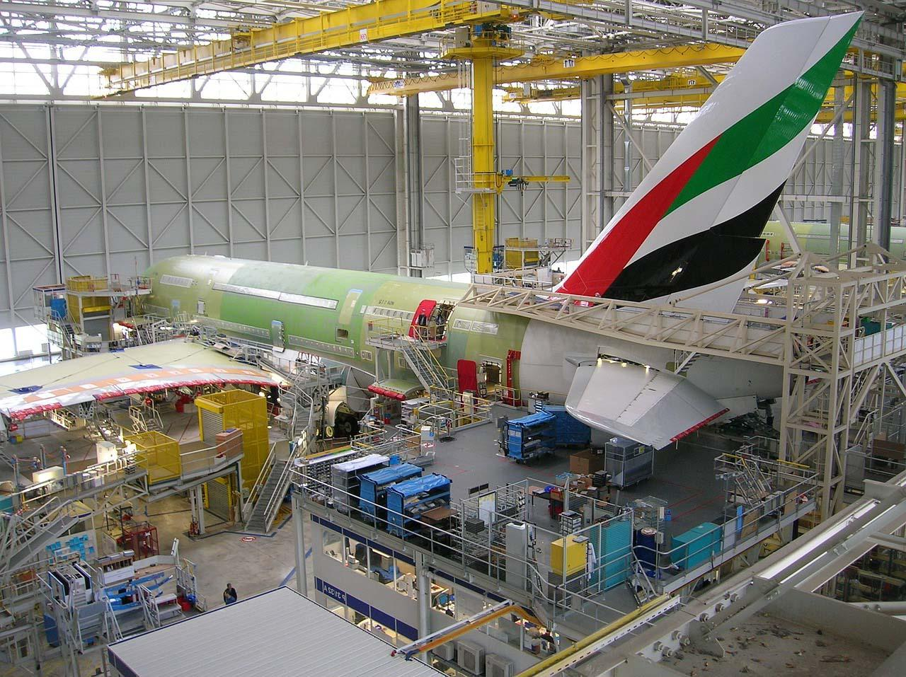
Innovation and the Circular Economy
The construction sector is conservative, where innovation has been slow over the past 20 years. Contrast developments in the manufacturing sector.
Task: Before starting this workshop think why has the sector been slow to innovate and develop new ways of working?
Circular Economy
and the Construction Sector
Notes:
There's a reasonable case to make that the construction sector has not been the most innovative of industries over the past 20 years. Contrast that with the manufacturing sector, such as car manufacture or aircraft build.
So it’s worth considering why this should be so before starting the workshop. Let's give some thought to why the sector has been slow to innovate, embrace technology and apply new ways of working.
At this point give the students the opportunity to think this through. There will be a number of reasons for this.
One might be that the sector operates on site and little scope for automation or standardisation.
Another is the that the sector is very labour intensive sector and the opportunity to improve this
A third reason might be the way the sector operates with different stakeholders with different areas of responsibility, and as we have seen, often the planning, design and build process is inhibited by the relationships between the different stakeholders.
So lets look at some of the innovation practices that are taking place – that may have an impact on the extend to which the sector can become circular.

Slide 4
Modular Design and Build
Notes:
Modular design and build is based around more efficient industrial manufacturing and prefabrication, where elements or components are brought together and assembled on site.

Slide 5
Modular Design and Build
In this section you will:
Gain understanding of modular building and applications
Identify Drivers, Benefits and Barriers to Modular Designs
Develop strategies to implementing aspects of circular economy in construction
Notes:
Modular buildings are all over the world, and has gained acceptance amongst developers, the government and contractors. Why has it become so popular? What are the benefits and the drivers for this innovation? How do modular build comply with aspects of circular economy ? These questions should be kept in mind as we run through the slides fo understanding and appreciation of this section.
Modular building methods are revolutionising the way we build - but why is it so popular?
Modular build when done well, can offer a number of benefits to a project.
These might be
reduced build cost and life cycle costs for the building
Shortened time scales for construction
More accurate costing under a controlled manufacturing process
and potentially improve quality of build.

Slide 6
Modular Buildings
What do you think of when you hear the term “Modular Buildings”?
Temporary Building?
Unattractive Boxes?
Low or poor quality rooms?
Small Rooms
Cheap Buildings
Notes:
In the past, modular builds (MB) were known as cheap post war houses quickly put together to provide shelter for the homeless. Usually a small low quality, temporal unattractive boxes with small rooms. The evolution of modular builds in recent times have had many reflecting on what it used to be.
Nowadays, It is much complex, desirable, quality and eco-friendly compared to traditional buildings.
It will be interesting to know the opinion of the audience on modular buildings.

Slide 7
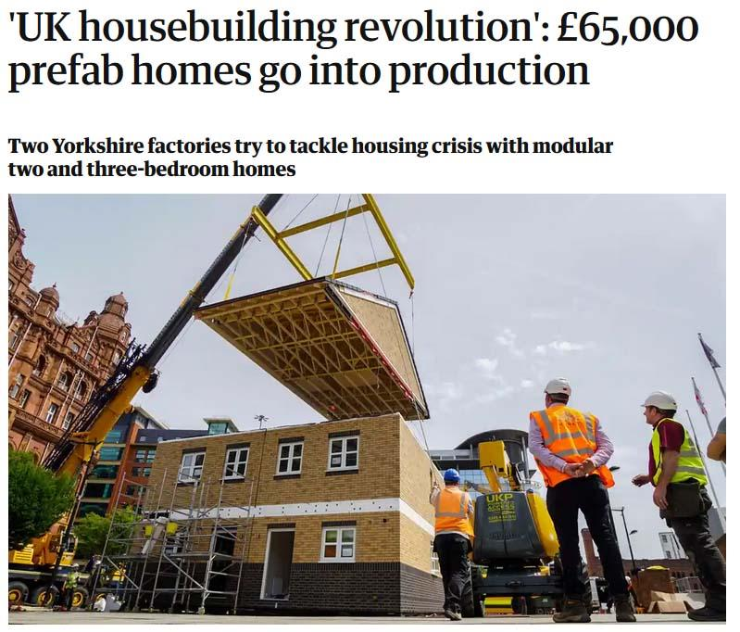
Modular Builds
Prefabricated Structures or modules
Designed and constructed in the factory
Delivered and coupled on site to form complete buildings
How widespread?
Very popular in Sweden, Japan, South Korea and Germany
Attracting a lots of interest in the UK
Worthing Council approval 162 homes to be built by IKEA
Opening of Yorkshire building factory – 2000 homes annually
Legal and General – investing in modular housing – 3000 homes annually
Source Guardian Nov 2018
Notes:
Just think about offsite construction in a controlled environment (factory) instead of the traditional on site building. The structures are transported to site and installed to form a complete building.
UK is behind in embracing the innovation compared to other European countries. For example, 85% of building in Sweden alone is modular build. However, there has been much interest and investments lately in the UK to fully embrace modular buildings. Many builders are being engaged and factories are being commissioned (Yorkshire and Kent) .Private investors are also looking to investing in MB.

Slide 8
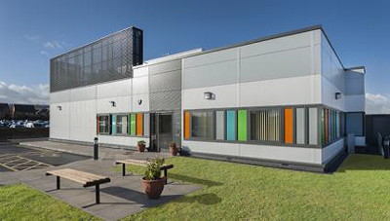
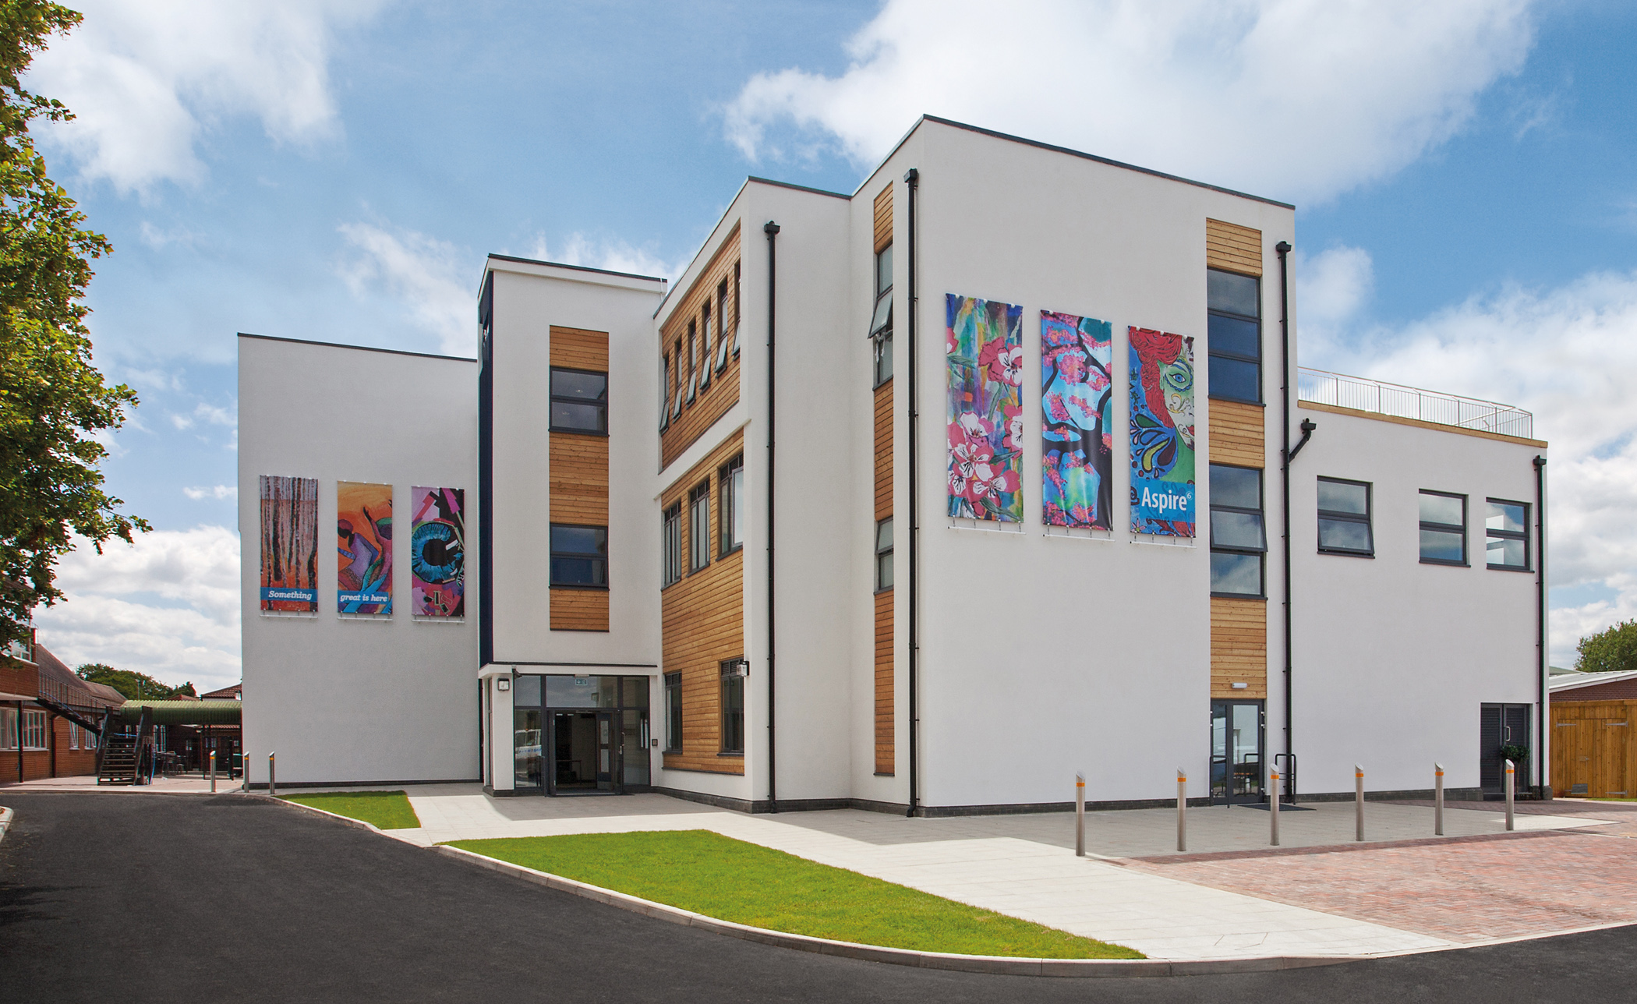
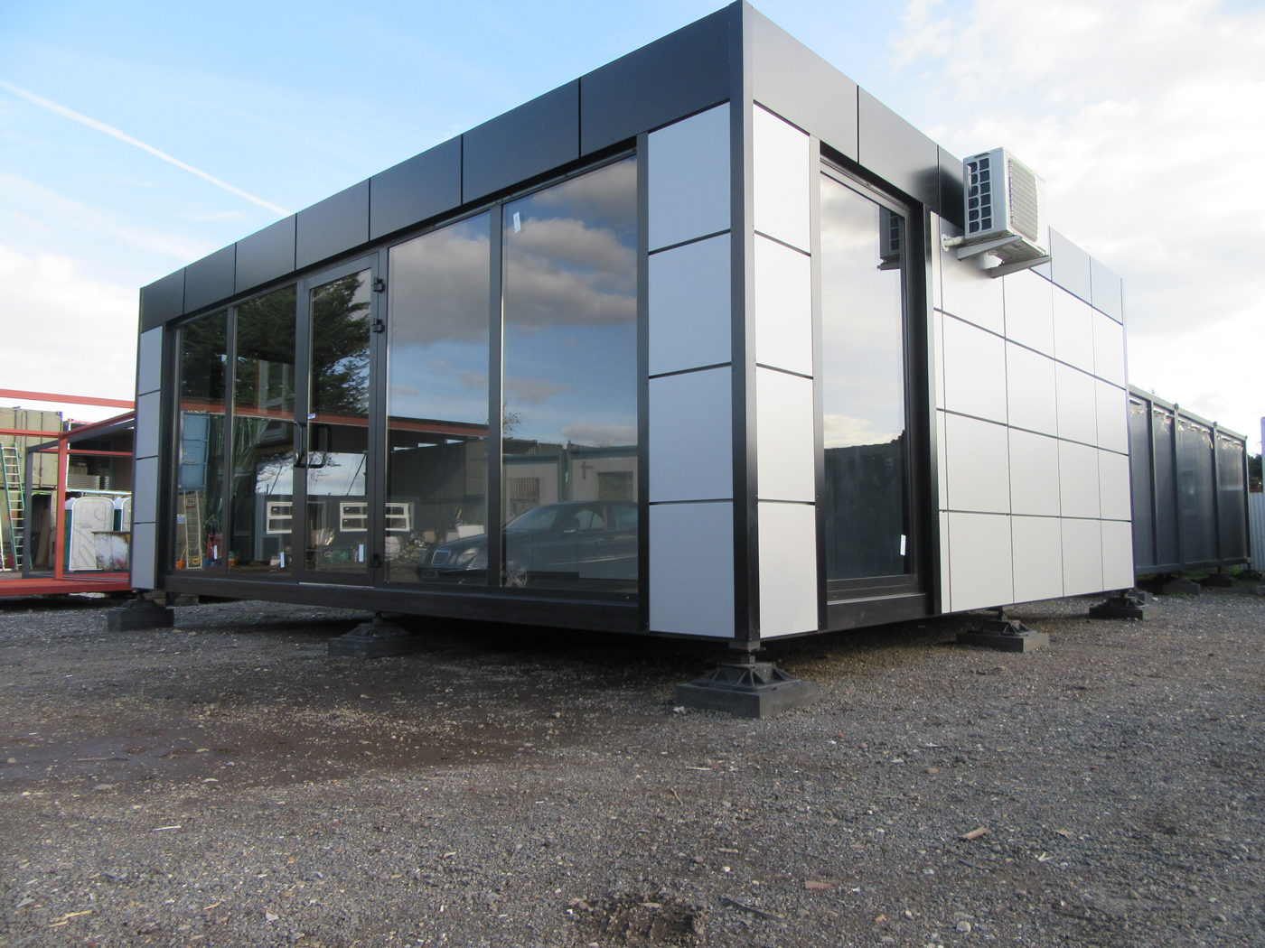
Which are modular?
Which of these buildings are modular?
Notes:
Test the audience to see if they could identify any as modular build or traditional build.
The answer is, they all are modular builds… despite the features that makes them look interesting. The structures range in complexity and shapes. They can incorporate different materials and can look better than the traditional built.

Slide 9
Applications of Modular Design
Real Estate
Education/ schools (Student accommodation)
Healthcare
Industrial facilities
Hotels
Offices
Public and private living homes
Check out the following link for Case Studies
https://www.premiermodular.co.uk/case-studies
Notes:
Modular buildings are versatile and can be used in range of different sectors. Some examples are Birmingham University, Office outlets, Manchester Royal Infirmary, Hotel Chains like Days Inn, Travel Lodge, and many more apartments and schools across the UK. check the link for more case studies. https://www.premiermodular.co.uk/case-studies

Slide 10
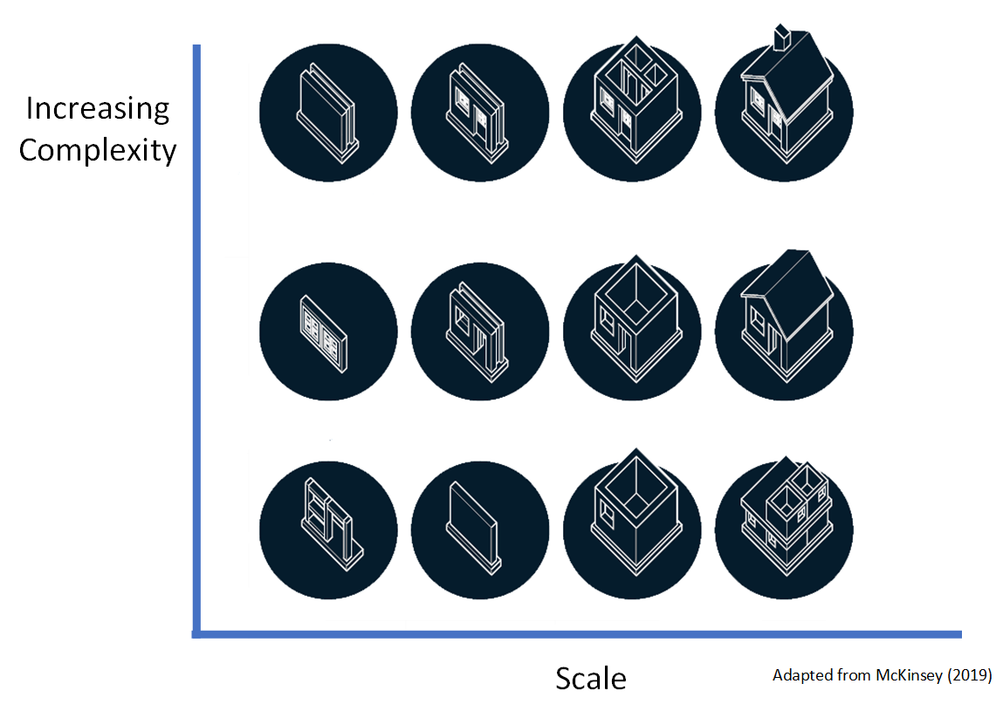
Group Exercise
The diagram shows that modular builds can vary in complexity and/or in scale
In groups discuss the drivers and motivation for adoption and investment in modular construction – particularly in relation to the circular economy
Notes:
The figure is taken from a recent McKinsey report and neatly demonstrates but modular build can vary not only in scale moving from single panels through to volumetric components, but also in terms of complexity as to what elements of the build are incorporated moving from simple panels through to inclusion of windows unknown to include other fixtures. In your group, consider what the drivers and motivation might be for the adoption and investment in the UK modular construction sub sector, specifically consider its inportnace in the context of the circular economy.
The group should reflect on the possible reasons for wanting to encourage modular builds in the UK especially.
The next slides gives some answers to this questions

Slide 11
Consider
PROMOTION OF CIRCULAR ECONOMY (WASTE REDUCTION)
DEPLETION OF FINITE RESOURCES
HOUSING CRISIS
NOT MEETING THE TARGET FOR 300,000 BUILDING PER YEAR BY TRADITIONAL BUILDERS
SHORTAGE OF SKILLED WORKERS IN CONSTRUCTION, LEADING TO HIGH COST HOUSES
Notes:
The need to eradicate waste in the construction sector and promote circular economy is one of the drivers for investing in modular building. Unlike the traditional builds, Modular building maximizes resources and promotes reusing and recycling of materials, thereby closing the loop and meeting the requirement of circular economy.
Depletion of finite resources is another reasons, hence the need for sustainable options. Application of modular designs will reduce pressure on natural resources as secondary materials could be used in achieving same results.
The shortage of living homes in the Uk, and less skilled workers to achieve the 300,000 yearly homes building target is huge motivation for this innovation in the Uk. With Brexit, the shortage of skilled workers is unavoidable.

Slide 12
Benefits of Modular Build - Time
Construction speed/ faster return of investment; saves up to 50% cost of production
Off-site manufacturing – modules fabrication and foundation works can be done simultaneously
Factory conditions – up to 90% of the construction work is completed indoors, eliminating delays associated with bad weather
Streamlined planning –less time spent in planning
Notes:
Unlije the traditional build (3 moths - 2 years), it takes 2 weeks to 2 months to complete and handover a modular house (depending on the complexity). They are not affected by bad weather conditions or skilled labour. This saves time and costs both for the builder and for the buyer

Slide 13
Benefits of Modular Build Environment
Reduced Carbon footprint: production energy 67% of normal builds. With lifetime energy savings of up to 90%
Reduction in construction site and traffic noise by 90%
End of Life Disposal – modular buildings are easily relocated, refurbished and repurposed. they are easy to dismantle and recycled, minimizing waste and environmental impact
Less Waste!
Notes:
Low carbon footprint is also as result of reduced vehicular movement to and from site, reduced fuel consumption and emissions from the construction activities.

Slide 14
Benefits of Modular Build Costs/Quality
Modules are controlled in strict environment and in line with building regulations and codes. Built to withstand construction and dismantling processes.
According to Mckinsey, it can save 20% of building costs and potential saving globally of $22b per annum.
Durability is estimated from 60 – 100 years
Notes:
Since the structures are manufactured in modules or pieces, there are strict quality checks to ensure they fit the purpose.
Due to the quality designs and checks, it is believed that some modular structures builts today will remain efficient in 60 to 100 years time. At the end of life, the structures will easily form part of a brand new building. As a result will save cost and eliminate waste.
Although the cost of land space needs to be considered. While modular houses are more affordable, the cost of land space could be a surprise.

Slide 15
Barriers to Modular Build
Peoples perception on quality
Lack of design standardisation and product offerings
Opportunity to make design changes once build started – impossible
Design freeze at start of build)
The multi-stakeholder relationships and the planning regime
Client/ designer/ Contractor
Mindset of the industry
Notes:
However, there are also potential barriers to modular buildings People may have a perception but prefabrication also means poor quality, possibly linked to prefabrication approaches to housing adopted in the 1950’s.
There may be a lack of standardisation on design and the range of modular products on offer to clients. It is certainly the case that there restricted opportunities to make design changes once a building has been selected and manufactured off site - so called design freeze at start of build . Also the relationships that exist between clients, designers, contractors, planners, building standards etc. All of these raise significant challenges and inhibit the modular build approach. Finally, there is probably inertia in the construction sector to embrace such new approaches to build.

Slide 16
Modular Building in Circular Economy
Group Exercise:
1. Discuss aspects of Modular Building that addresses the concept of Circular Economy.
2. Discuss strategies that can be adopted by builders to meet the requirement of circular economy in construction.
Notes:
The group should at this point be able to explain how modular builds fits into the requirement of circular economy, and how the builders can apply the concepts.
This will show their level of understanding of the concept so far, having in mind the process of modular building. For example, they should consider the material sourcing process (opportunity to incorporate secondary materials) , to construction process (Eliminating waste from design and construction) to end of life usage.
The next slide will address this.

Slide 17
Modular Building in Circular Economy
Waste reduction at the design and production phase/ lean production chain
90% use of secondary materials (scrap, waste, steel etc) into new components
Adaptability of the buildings and extension of life during operational stages
Dismantling into components for reuse or recycle
Traceability/storage of materials (buildings as material banks)
Notes:
To achieve these CE models, the builders should do the following:
Develop project specifications which encourages the use of secondary/recycled materials in place of the new ones. Acceptance of secondary materials such as crushed rocks, slabs, and concrete in project specification will increase the demand for secondary materials within the supply chain.
Engage skilled contractors in modular building and waste minimization technique. Request these during tender phase.
Design the major part of the structure with supply, install, maintain and remove approach in mind. Where materials are not resusable, it should be recyclable This way, materials life cycle will be extended.
Integrate light movable steel frame on the buildings external structures to increase the adaptability of the internal spaces.
The use of barcoded components would enable buildings to become material banks at the end of their life cycle. This can be achieved using incorporated barcoded BIM models.

Slide 18
Modular Build - Conclusion
Huge demand for housing exists in the UK and abroad
Pressure on finite resources and to build efficiently requires new methods of build
Prefabrication and delivery/ assembly onsite is aligned to the principle concept of the circular economy – reduction of waste and better use of materials
Leads to wider construction efficiencies and cost savings
Notes:
It is widely acknowledged that there is a huge demand for housing in the UK But with pressure on finite resources and materials coupled with the need to build efficiently both in terms of materials and labour , we need to consider new methods of build. Prefabrication and delivery/assembly on site is aligned to the principle of the circular economy which looks for reduction of waste better use of metallic materials. This offers significant potential to construction efficiency and cost savings as well

