Slide 1
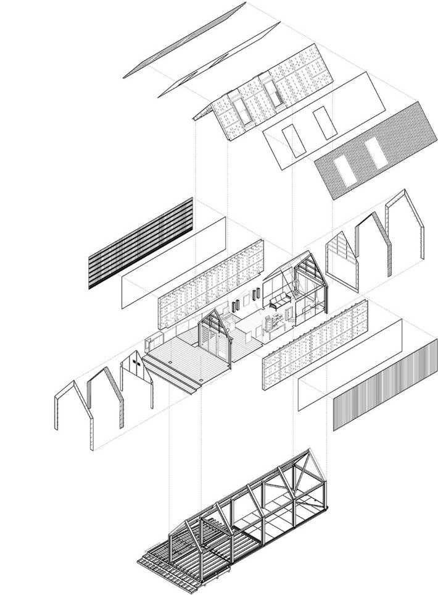



Circular Economy
and the Construction Sector

Slide 2

Session 2
Construction and the Circular Economy
Circular Economy
and the Construction Sector
Notes:
Session 2 looks specifically at Construction and the Circular Economy…

Slide 3
Session 2
Construction and the Circular Economy
Waste Hierarchy Concept
Challenges and Barriers
Opportunities in the Circular Economy
Circular Economy
and the Construction Sector
Notes:
These are the three Topics we will cover in session 2.

Slide 4
Session 2
Learning Outcomes
On completion of this session you should:
Be able to explain the concept of a waste hierarchy and how it can be used to prioritise waste management
Have an understanding of the tools which can assist in reduce reuse recycle in the construction sector
Be able to recognise the importance of collaboration at an early stage in the build process
Circular Economy
and the Construction Sector
Notes:
These are the Learning Outcomes you will be expected to achieve within this session.

Slide 5
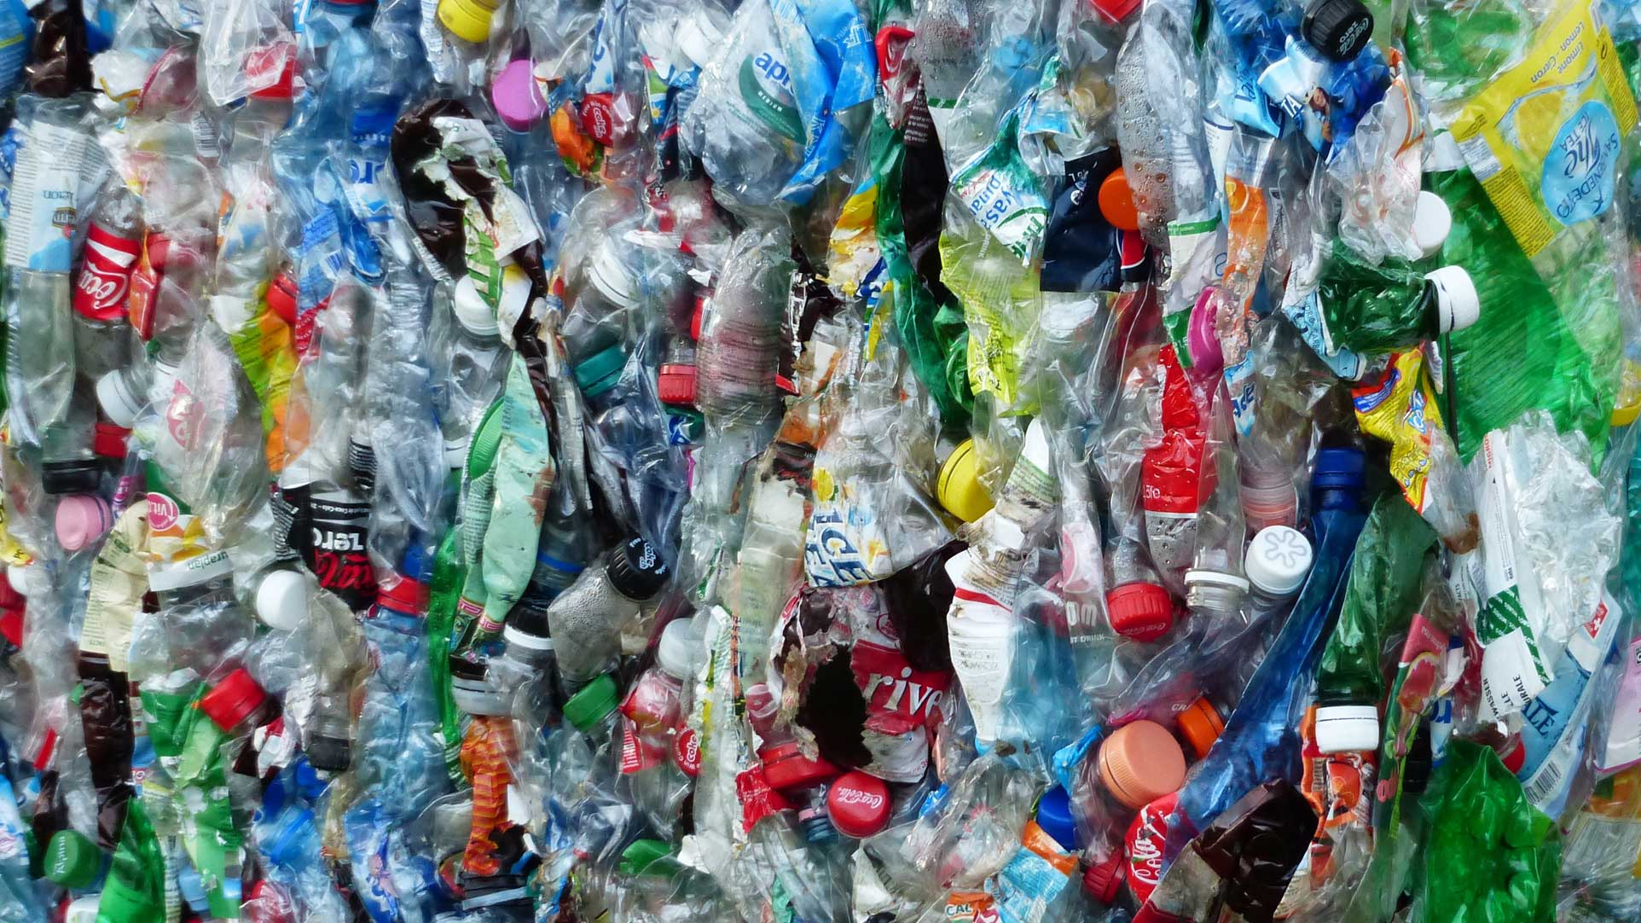
The
Waste
Hierarchy…
Notes:
At the core of the Circular Economy concept, in construction in particular, is the principle of Waste Reduction. The Waste Hierarchy Model is an environmental waste management tool to illustrate how the reduction of waste should be achieved, particularly with respect to the use of materials. This is of great relevance to the Construction Industry.

Slide 6
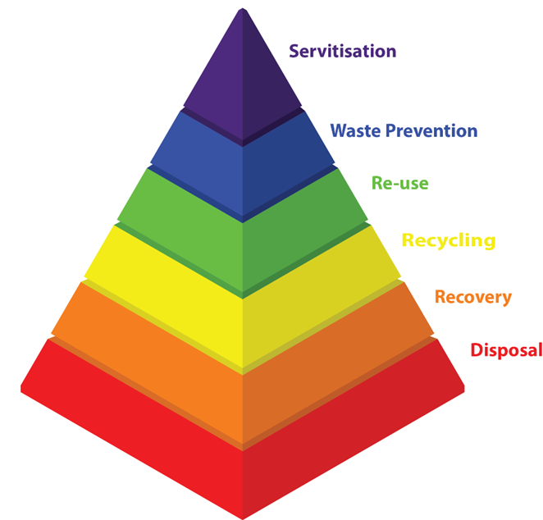



The Waste Hierarchy
Prevention
Most Preferable
Reuse / Repair
Remanufacture
Recycle
Recovery
Disposal
Least Preferable
Circular Economy
and the Construction Sector
Notes:
This diagram illustrates the Waste Hierarchy model. It operates on the basis of extracting maximum value from the resources we use. It sets out a scale of preference for different Circular practices, from Prevention of the need to undertake an activity or replace a product, through to the least preferable option of Disposal or Landfill, which should be avoided altogether where possible. It is important to understand the differences between each layer of the Waste Hierarchy…

Slide 7
The Waste Hierarchy
Defining the Terminology
Most Preferable
Prevention: Streamlining from the start. Questioning whether a building is needed in the first place, to minimising raw material use.
Reuse & Repair: Retaining a product for it’s original purpose for as long as
possible, using good maintenance or repair.
Remanufacture: Recovering, disassembling, repairing, reassembly,
resulting in a fresh as new product similar to the original.
Less Preferable
Circular Economy
and the Construction Sector
Notes:
These definitions are set out to improve / clarify your understanding of the terms, as they apply to the Waste Hierarchy. They apply to decision-making by all construction project Stakeholders, at all stages of a building lifecycle, but particularly at the design and conception stage of a new building project or conversion / adaptation.
Prevention: This asks stakeholders to first consider whether a new project needs to be undertaken. Also, to consider not using, or eliminating the need for new materials or products. It is essentially the process of streamlining in advance of actions being taken. For Construction Clients, this may involve seriously questioning whether a new building is needed in the first place, or the minimisation of using non-circular products or new raw materials.
Reuse & Repair: Going further to retain a product for it’s original purpose for as long as possible, utilising good maintenance or repair. At present many items that could be used by others, such as washing machines or sofas, go to landfill. In Scotland, 304,000 individual 3-seater sofas and 151,000 washing machines end up in landfill (https://www.zerowastescotland.org.uk/circular-economy/reuse-repair). Many of these items still have a lifespan when they are disposed of and therefore provide an opportunity to realise the ambitions of the Circular Economy.
Remanufacture: Recovering, disassembling, repairing, reassembly, resulting in a fresh as new product similar to the original. This involves more processing than ‘Repair or Reuse’, with re-manufacturing companies requiring transport for collection and facilities for the re-manufacturing process. The benefit of this process is that in theory the product can be returned to it’s original value, retaining it’s potential via a process that involves fewer new raw materials.

Slide 8
The Waste Hierarchy
Defining the Terminology
Less Preferable
Recycle: Typically a downgrading process involving the breaking
down or re-processing of a product into a new product with
inferior integrity to the original.
Recovery: Recovery of energy or fuel from a resource at the end of it’s
lifespan e.g through incineration or anaerobic digestion.
Disposal: Residual waste may occur on occasion. Treatment of waste
should be considered before finally sending to landfill.
Least Preferable
Circular Economy
and the Construction Sector
Notes:
Recycling: Typically a downgrading process involving the breaking down or re-processing of a product into a new product with inferior integrity to the original. For example, the Nike Grind product (https://www.nikegrind.com), which uses the recycled soles of trainers to create rubber surfacing for play areas or sports fields, is a product that will need to be disposed of once it has been used. Although it uses a product that was previously waste – it does not retain the value of the rubber soles beyond the first recycling process.
Recovery: Recovery of energy or fuel from a resource at the end of it’s lifespan e.g through incineration or anaerobic digestion. This may be a more beneficial process than sending to Landfill in many circumstances.
Disposal: Residual waste may be inevitable in certain circumstances, even if the above processes have all been considered and undertaken properly. Disposal to Landfill may be the result, but treatment of waste to remove harmful or hazardous substances should be considered even in advance of landfill.

Slide 9
The Waste Hierarchy
Prevention
EMBODIED CARBON
Reuse / Repair
Circular Economy:
Low Whole Life Carbon
Remanufacture
Recycle
Recovery
Disposal
Linear Economy:
High Whole Life Carbon
Circular Economy
and the Construction Sector
Notes:
In terms of our practices in the Construction Industry, when reflecting back on the waste hierarchy as a whole, it is important to note that by achieving the most preferable levels of waste reduction, a concurrent reduction in embodied carbon will occur. Again, we can see that the Circular Economy and the drive to reduce carbon emissions are mutually beneficial.

Slide 10
The Waste Hierarchy
Existing Practice
PREVENTION
Planning tools such as Net Waste Tool are designed to help plan for the avoidance of waste generation and provide insight into the potential savings
REUSE AND RECYCLING
The use of Site Waste Management Plans as a site-based approach to identifying waste and segregation will provide financial savings through material reuse and recycling and avoided landfill costs.
Circular Economy
and the Construction Sector
http://nwtool.wrap.org.uk/ToolHome.aspx
Notes:
At present, there are circular practices that are used in the Construction Sector, which include the following:
PREVENTION
Early planning and smart design thinking can go a long way to avoid the generation of waste. Planning tools such as Net Waste Tool are designed to help plan for the avoidance of waste generation and provide insight into the potential savings
REUSE AND RECYCLING
Construction waste is inevitable, but the use of Site Waste Management Plans as a site-based approach to identifying waste and maintaining on-site segregation will provide financial savings through material reuse and recycling and avoided landfill costs.
It must be stressed that these may be contributory factors in working towards a Circular Economy, but they do not close the loop entirely and will need to be supported by a number of further steps / measures.
Existing Practice: House Building
Report by BRE suggests that 12 tonnes of waste is produced per 100 m² of property.
Over a typical semi-detached property this will result in:
Loss of £1500 of material value (purchased)
£800 in disposal costs
However, through the use of good site waste management it is possible to reduce the disposal costs to net zero.

Slide 11
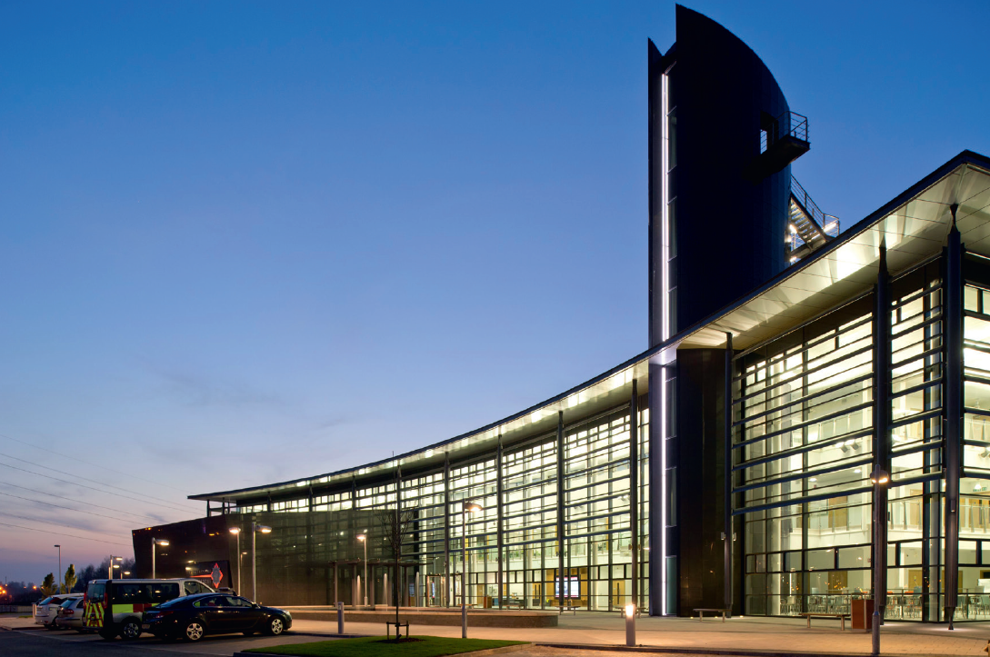
Case Study – Strathclyde Fire and Rescue Training centre
Lend Lease worked with BRE Smart Waste and their own Minimise tool to apply a nine step waste reduction strategy
At the project start 3925 tonnes of waste was predicted using established practices
Project produced 1,527 tonnes – a saving of 2,298, mostly achieved through the avoidance of inert materials
Notes:
Strathclyde Fire and Rescue Training Centre in Cambuslang, by Cooper Cromar:
Lend Lease worked with BRE Smart Waste and their own Minimise tool to apply a nine step waste reduction strategy
At the project start 3925 tonnes of waste was predicted using established practices
Project produced 1,527 tonnes – a saving of 2,298, mostly achieved through the avoidance of inert materials
This has the effect of reducing the embodied carbon levels within the manufacturing and construction stages.

Slide 12
The Waste Hierarchy
Q: How do we further develop the implementation of the Waste Hierarchy in Construction?
Prevention
Reuse / Repair
Remanufacture
Recycle
Recovery
Disposal
Circular Economy
and the Construction Sector
Notes:
How do we further develop the implementation of the Waste Hierarchy in Construction? Does the idea of a Site Waste Management solution go far enough? Should it be the Contractors’ job to principally manage waste reduction targets on construction projects?
These are questions that we should bear in mind as we continue through the session.

Slide 13
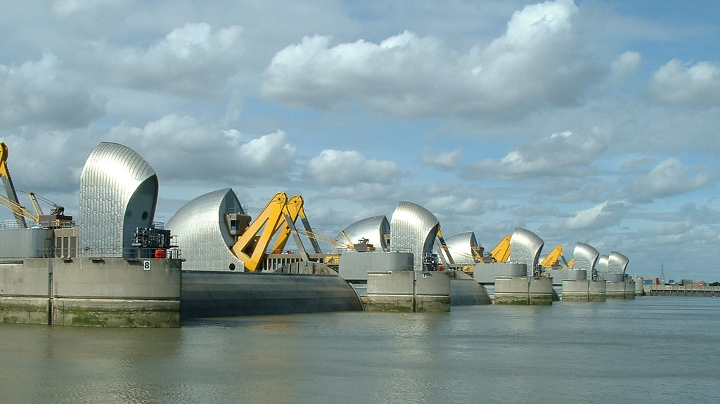
Barriers & Challenges
Notes:
What are the main challenges and barriers we can foresee in implementing Circular principles in Construction, can we think of any? Here are some examples, illustrating how engrained the Linear system is at present.

Slide 14
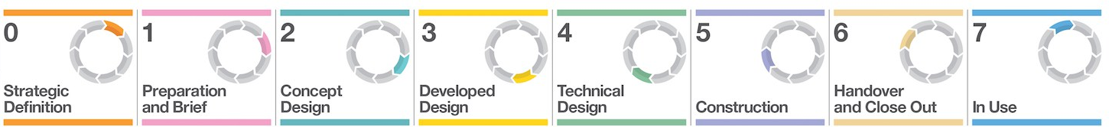

Barriers & Challenges
Linear Model: Waste as a Reactive By-product
Source: RIBA Plan of Work
The most prevalent examples of waste reduction revolve around how we deal with waste in a reactive manner on site…
dispose
recycle
recover
Circular Economy
and the Construction Sector
Notes:
Waste as a Reactive By-product:
Within the current Linear Economy model, the most common examples of waste reduction in construction revolve around how we deal with waste in a reactive manner on site.
With reference to the RIBA Plan of Work - this relates to the latter stages of a building project. For example, the segregation of waste on site for recycling purposes. This waste may not always be re-usable in the state it is recovered from site, as it may not have originally been designed to be recovered. Considering waste only at this late stage in the Plan of Work means that resources are likely to lose a significant proportion of their value.
The result of this approach to waste reduction is that often it is only the latter 3 tiers of the waste hierarchy may be considered / achieved: Recycling, Recovery and Disposal.

Slide 15




Barriers & Challenges
Linear Model: Sequential and Separate Processes
Source: RIBA Plan of Work
client
design team
client / facilities manager
contractor
manufacturer
trades
Circular Economy
and the Construction Sector
Notes:
Sequential and Separate Processes:
If we again consider the linear model in relation to the RIBA Plan of Work. Traditionally this has been a linear process, with clients appointing a design team to come up with proposals, obtain consents and then assist with the tendering process. Thereafter a contractor is appointed to work with suppliers, manufacturers and tradespeople to construct the building. Once complete, the client takes possession of the building and their maintenance team are responsible for the upkeep of the building that they have inherited. We can even then think beyond the lifespan of the building, to the demolition contractors who take it all down.
Whilst clients and designers think about specifying sustainable materials or renewable technologies with increasing regularity, it is still most common for them to work in isolation from the contracting / supplier team until towards the construction stage of a project. This means considerations of buildability, maintenance and demolition are frequently under-informed.
Whilst the Linear system clearly has it’s problems, many in the Construction Industry are Risk Averse, and it will be difficult to convince clients / contractors to disrupt existing supply chains to give Circular Practices an opportunity.

Slide 16
Barriers & Challenges
Linear Model: Few Incentives Beyond Construction
Source: RIBA Plan of Work
?
There are few incentives for Contractors and Suppliers to be invested in the In-Use or Demolition phases of a building life-cycle (e.g maintenance). The commitment to the longevity of a building is therefore be diminished.
Circular Economy
and the Construction Sector
Notes:
Few Incentives Beyond Construction:
Within the current Linear System, there are few incentives for Contractors or Suppliers to be invested in the In-Use / Demolition phase of a building life-cycle (e.g maintenance / demolition). The commitment to truly optimising the longevity of building is therefore diminished for a significant proportion of a project team.
In Traditional Contracts, liabilities reduce on completion of a relatively short maintenance period, typically a year after completion / use. Thereafter, maintenance passes entirely over to the client. Once the initial maintenance period has elapsed, the Contracting parties are far less invested in the performance of the building.
Additional:
Further barriers exist in the following areas:
Challenging Preconceptions: Convincing buyers of the value of re-used or recycled materials involves breaking down certain preconceptions. Are recycled materials as reliable as new?
Challenging Business Models: Can a profitable system be established that encourages sustainable sourcing, maintenance and continued re-use over a product lifespan?
Futureproofing: Can we futureproof buildings or products so that we do not render them obsolete when the time for reuse arrives.
Risk Averse Culture: There is naturally a risk averse culture in Construction. Convincing businesses to disrupt existing supply chains in order to implement wider changes may be difficult.

Slide 17

Opportunities…
Notes:
What Opportunities does the prospect of a Circular Economy present. How do the people driving CE further convince the remaining sceptics that it is an economically viable cause, as well as a worthy one?
The picture above is from the People’s Pavilion in Eindhoven, by Arup and Dutch Architects Overtreaders W & Bureau SLA. The project aimed to create a building for the Dutch Design Week 2017 using 100% borrowed materials, which then had to be dismantled at the end of the festival, with all materials returned to their original suppliers, in their original state. It was an exercise in realising a circular building. A further challenge set by the client was that the building needed to have a high architectural quality. The image shows the building’s recycled plastic shingle cladding, made from the domestic waste of local residents. These shingles were designed to reused on other projects, with minimal repair, following the dismantling of the pavilion. Construction techniques that avoided glue or nails were devised to eliminate damage to the original materials. This included Arup’s innovative structural design, which featured a tension-belt system (https://www.arup.com/projects/peoples-pavilion).
https://www.dezeen.com/2017/10/27/peoples-pavilion-dutch-design-week-low-ecological-footprint-bureau-sla-overtreders-w/

Slide 18
Opportunities
Circular Economy: Tackling Waste by Design
prevent
Within the Circular Economy, there is the opportunity to consider circularity and waste reduction proactively, from the beginning of a project…
reuse
dispose
remanufacture
recover
recycle
Circular Economy
and the Construction Sector
Notes:
Tackling Waste by Design
Within the Circular Economy, there is the opportunity to consider circularity and waste reduction proactively, from the beginning of a project, in order to benefit the future use and demolition cycles of the building. This way of thinking brings in the aspects of Prevention, Reuse / Repair and Remanufacture from the Waste Hierarchy model.
For the Circular Economy to work, we must begin to consider circularity from the very beginning of a project. This is true across all industries and demands more forward-thinking and integration of CE principles at the earliest possible stage. There are examples of how this can / has been achieved in later slides and we will delve further into the practical applications of Circular Construction in Design.
For this consideration of waste in design to be most effective, it cannot simply be left to what is traditionally considered as the design team (Architect, Engineer, M&E, QS etc.) to resolve, in the early phases of a project…

Slide 19



Opportunities
Circular Economy: Opportunities to for Design Collaboration
client
design team
contractor
manufacturer
Source: RIBA Plan of Work
trades
facilities manager
demolitions
remanufacturers
Circular Economy
and the Construction Sector
Notes:
Opportunities to for Design Collaboration
The Circular Model aims to encourage the expertise of all of these parties to inform the design of the building, to better prepare for the longevity of the building and the materials or products it contains. For example, can all materials be scheduled during design to eliminate excess being ordered (perhaps assisted by BIM processes)? Or can technical detailing consider the dismantling process? Practical examples include increasing mechanical fixings and reducing the use of adhesive fixings in order to better preserve downtaken materials. These are things that will benefit from collaboration between designers and those who will physically dismantle the building.
Additional:
The CE design process aims to meaningfully involve all parties at various stages of a building lifespan, in design. This includes; clients – designers – contractors – manufacturers / fabricators – builders - facilities managers - demolition contractors – remanufacturing / waste contractors.
Within Further Education, this may suggest that greater collaboration, team-working and communication between different professions and disciplines would be beneficial. This approach would help to foster the respect and understanding of the respective roles of construction project stakeholders.
Circular Design in construction emphasises the following outcomes:
Design for Longevity
Design for Flexibility
Design for Adaptability
Design for Assembly, Disassembly and Recoverability
Whilst highlighting the following:
Use low impact / sustainably sourced new materials
Use recycled content or secondary use, refurbished products
Designing out waste
Reduce construction impacts on the environment
Examples of how this may be achieved include:
Selecting local materials
Using only the quantities required
Considering transport efficiency
Considering energy efficiency

Slide 20

Opportunities
Circular Economy: New Incentives for Post Construction?
Source: RIBA Plan of Work
Within a Circular Economy, potential new business opportunities in Maintenance, Remanufacturing and Dismantling can exist.
8
?
Dismantling /
Remanufacture
Circular Economy
and the Construction Sector
Notes:
New Incentives for Post Construction?
Within a Circular Economy, potential new business opportunities in Maintenance, Remanufacturing and Dismantling can exist.
Maintenance: If there were incentives for contractors or suppliers to take on maintenance contracts for their work, post-construction, then there would greater incentives to ensure the optimum value of building materials during the construction phase.
Remanufacturing: An industry can flourish which preserves the value of materials and resources at a higher level than that of the recycling industries. An opportunity to see waste as an asset.
Dismantling: As distinct from demolition, a process that involves greater care and preservation in its process.
Clearly the Circular Economy proposes a number of changes to the Status Quo; it is a disruptive model, but one with a number of interesting potential business models, as our third slideshow will demonstrate.
In order to encourage greater standards in production, there needs to be greater incentives for clients and contractors post-completion. The true value in the creation of a high-quality, well maintained building needs to be established.

Slide 21
Opportunities
Q: Is wide collaboration in design an opportunity for progress or a recipe for disaster?
Circular Economy
and the Construction Sector
Notes:
QUESTION TO AUDIENCE: Is wide collaboration in design an opportunity for progress or a recipe for disaster? Discuss.
Can we do more to encourage cross-discipline collaboration in Further Education?

Slide 22
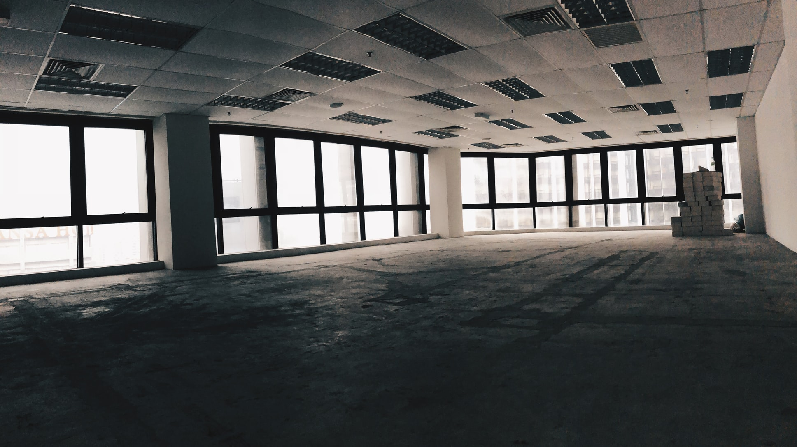
Opportunities
Underuse & Prevention
In considering the first preference in the waste hierarchy (prevention), it is also worth noting underuse in our current building stock:
60% of European office space is unused during working hours
49% owner-occupied homes in the UK are ‘under-occupied’
20% of retail space in New York City is vacant and fit for other purposes
(The Ellen Macarthur Foundation)
Notes:
A couple of final thoughts before session 2 comes to an end:
In thinking about opportunities, there is already great potential within the existing built environment that remains untapped.
In considering the first preference in the waste hierarchy pyramid (prevention), it is worth noting the reporting of underuse in our current building stock:
60% of European office space is unused during working hours
49% owner-occupied homes in the UK are ‘under-occupied’
20% of retail space in New York City is vacant and fit for other purposes
(The Ellen Macarthur Foundation)
https://www.ellenmacarthurfoundation.org/assets/downloads/Buildings_All_Mar19.pdf
This illustrates that there may be great value in considering whether a new building is required in the first place. These statistics would suggest there are more instances where this could be taking place.

Slide 23
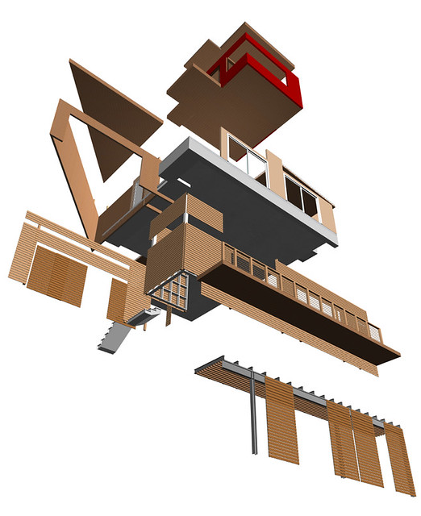
Opportunities
Opportunities in the Scottish Construction Sector:
Opportunity 1 – Modular Design (inc. deconstruction & Material Passports)
Opportunity 2 – Circular Timber in Construction
Opportunity 3 – Circular Aggregates (inc. concrete, brick etc.)
Opportunity 4 – Structural Steel and Aluminium Reuse
Opportunity 5 – Closed loop and lean use of plasterboard
Opportunity 6 – Making retrofit and refurb more circular
Opportunity 7 – Infrastructure & Regen. Projects (mat. banks & reuse hubs)
Opportunity 8 – Improving Building Utilisation and Usage
Source: Zero Waste Scotland
Circular Economy
and the Construction Sector
Notes:
Opportunities in the Scottish Construction Sector:
What opportunities exist within Scotland?
In terms of relating the practical opportunities that exist to the Scottish Construction Sector, Zero Waste Scotland published a report in April 2017 that looked specifically at opportunities within Scotland’s Construction Sector for CE opportunities (https://www.zerowastescotland.org.uk/sites/default/files/Circular%20Economy%20Opportunities%20in%20Construction%20-%20Nov2017.pdf).
This report focussed on identifying a shortlist of realistic / tangible opportunities, including:
Opportunity 1 – Modular Design (including design for deconstruction & Material Passports). The latter involves including all materials or products in a database for that building. The database would include information on where each item is located within the building and a description of it’s reuse potential. This may in turn involve each resource within a building containing a code that can link it back to the database. Buildings could then begin to be considered as material banks that have a reuse value, either wholly or in part (https://www.bamb2020.eu/topics/materials-passports/circular/ ).
Opportunity 2 – Circular Timber in Construction. Interestingly, considering over-engineering or optimal timber quality at design stage, may increase the re-use value / potential of timber. Here Circularity (long-term thinking) conflicts with the principles of Lean Construction (shorter-term, maximizing value of up-front, capital cost).
Opportunity 3 – Circular Aggregates (including concrete, brick, soild and stones).
Opportunity 4 – Structural Steel and Aluminium Reuse.
Opportunity 5 – Closed loop and lean use of plasterboard
Opportunity 6 – Making retrofit and refurbishment projects more circular
Opportunity 7 – Infrastructure & Regeneration Projects (including material banks & reuse hubs)
Opportunity 8 – Improving Building Utilisation and Usage
These are some of the CE opportunities within the Scottish Construction Sector that are actively being explored.
This leads us into our final slideshow, which looks at existing and proposed Business Models for the Construction Industry, within a Circular Economy.

Slide 24
Session 2
Construction and the Circular Economy
Waste Hierarchy Concept
Challenges and Barriers
Opportunities
Circular Economy
and the Construction Sector
Notes:
Here is a reminder of the topics covered in the second slideshow.

