Slide 1
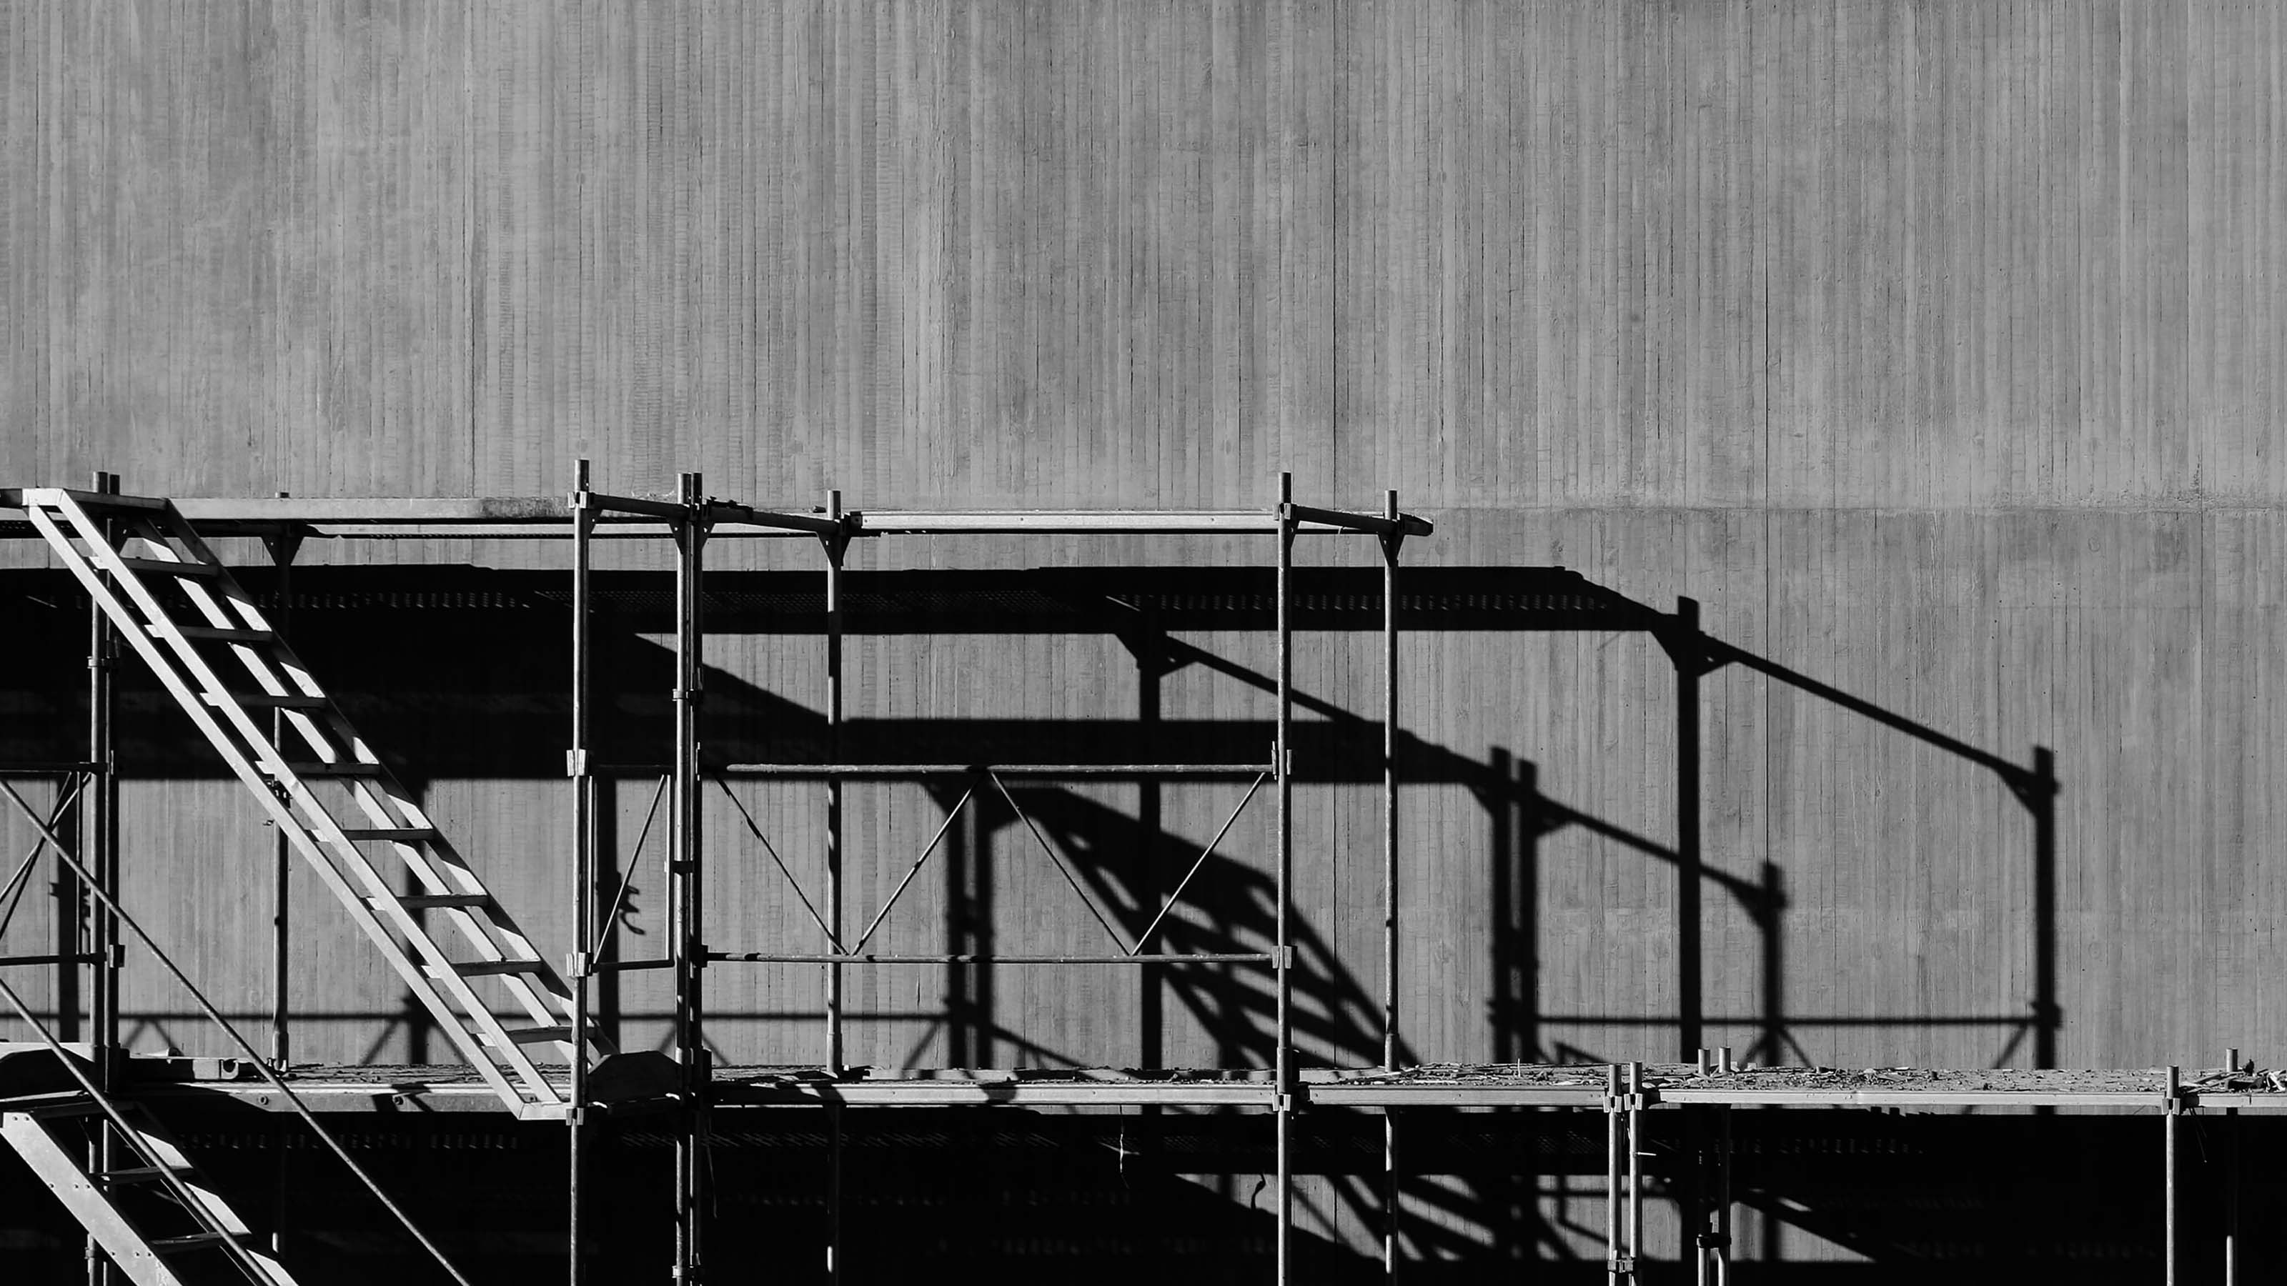



Circular Economy
& the Construction
Sector

Slide 2
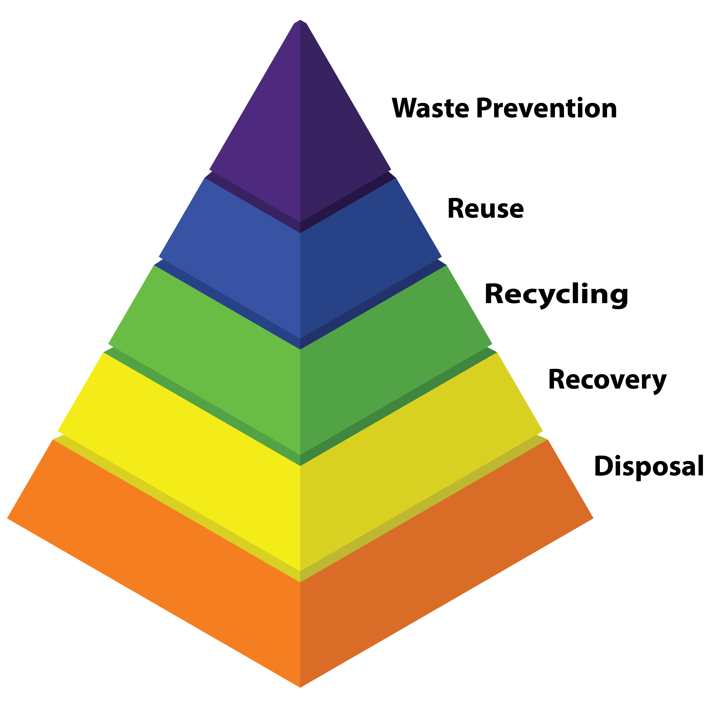
Workshop 1
Reduce, reuse, recycle
In Session 2 we described the waste hierarchy as an approach for tackling waste management in construction.
Its better to avoid producing waste in the first instance (prevention)
Having produced the waste we should first:
  look to reuse it rather than then recycle it
  Then better to have it recovered in the form of energy than dispose it to landfill
Reduce, reuse , recycle!

Slide 3

Why does waste occur?
Construction waste occurs for many different reasons, at different stages of the construction process.
Different types of builds – roads, infrastructure, retail, office developments, housing – each produce different wastes.
Projects which require a site to be cleared will have demolition waste
Exercise: In small groups discuss and identify causes of construction waste generated throughout the construction cycle

Slide 4
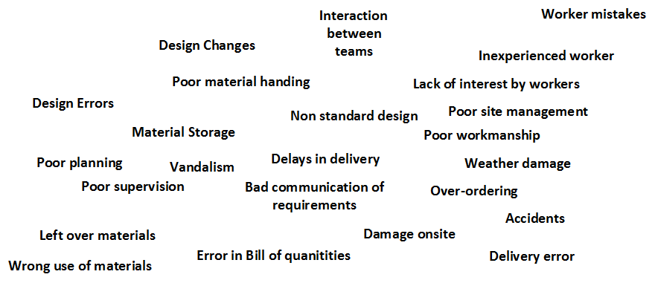
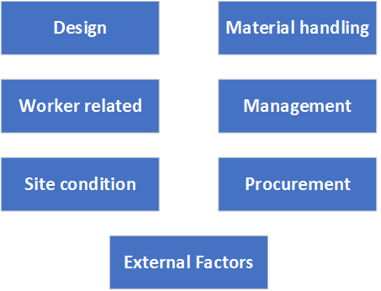
Why does waste occur?
It’s likely you identified some of the following causes
But these can be broadly categorised into the following categories

Slide 5
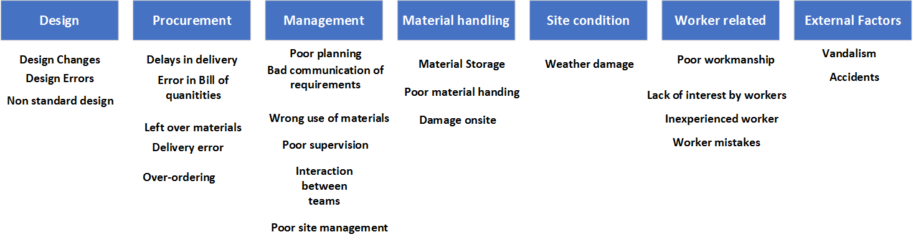
Why does waste occur?
Which categories did your own causes fit into?

Slide 6
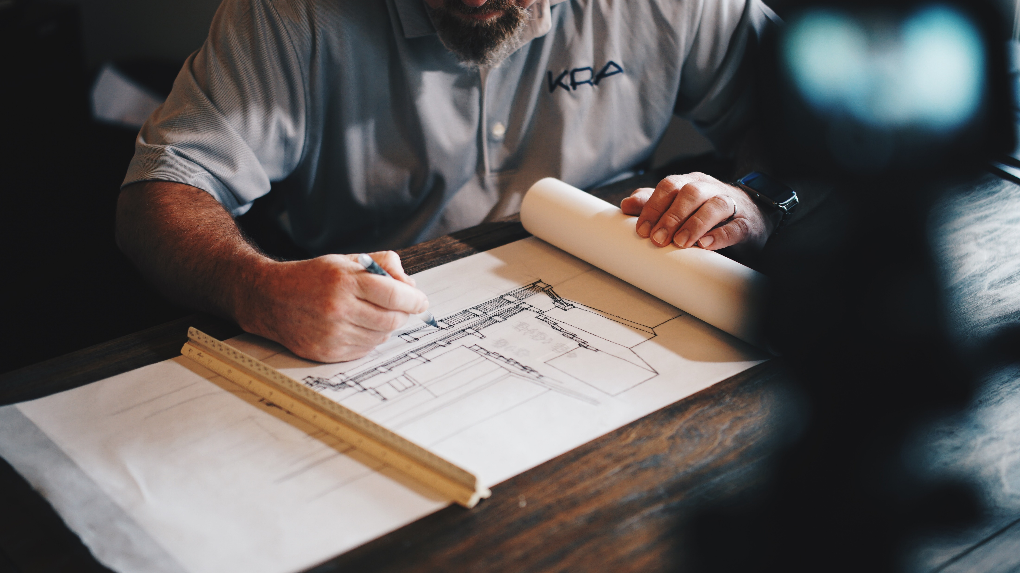
Opportunities to improve
Having identified causes of waste lets look at what opportunities and approaches exist to implement this waste hierarchy of reduce, reuse, recycle:
Design: 1/3 of all site waste is due to architects’ failure to implement waste reduction measures.
Architect view: Another survey of leading architects attributed the causes to:
Last minute client changes
Detailing errors
Unclear specification
Lack of information on drawings
Delays due to drawing revision and distribution
Notes:
So having identified all these potential causes of waste, we should consider how we might put processes in place to avoid them
What is clear is that design plays a key part.
One study suggested that one third of all site waste is due to architects’ failure to implement waste reduction measures at the design stage
Another survey of the 100 top architectural practices in the UK reported a number design causes.
Innes 2004 (see Osmani;s paper)

Slide 7
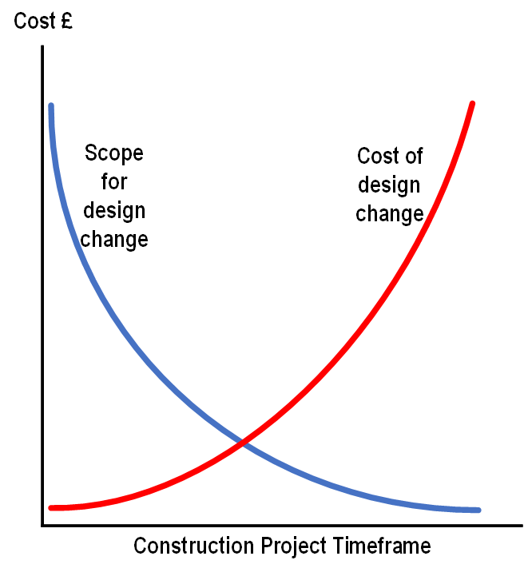
Importance of design
It is widely reported that 70-80% of a product’s cost is committed and defined at the conceptual design stage
The impact of design changes have a direct impact on costs as well as waste
Notes:
Corbett in a widely reported paper suggested that 70-80% of a product’s cost is committed and defined at the conceptual design stage. At a time when the client and the designer will have their greater communications.
The impact of design changes have a direct impact on costs as well as waste. The diagram shown illustrates that at an early stage in the design and build the scope for design change is greatest with minimal cost impact, while any client imposed changes at a later stage become limited and at greater cost.

Slide 8
Designing out waste
In its guide for design teams Zero Waste Scotland sets out five key principles around how to design out waste. They are all interlinked and together can deliver reductions in waste that can be achieved at the design stage
Efficient procurement
Materials optimisation
Off-site construction
Reuse and recycle
Deconstruction
Notes:
Introduction – A recent guide produced by ZWS is intended to help architects, quantity surveyors, engineers, construction project managers and more importantly, clients make design decisions that can reduce waste:
Design for waste efficient procurement – Early communication with all stakeholders to ensure what is being procured will reduce waste. Non standard specifications are an obvious potential to generate waste, and scope for avoiding in the design should be considered.
Design for Materials optimisation – Are there materials that can be selected that avoid waste, or at least can found further reuse through recovery later on.
Design for offsite construction – prefabricated components, including panels or even volumetric units can be produced aand generate less waste in a controlled factory environment.
Design for Reuse and recovery - At the material level what material choices can be made that extend the life of the building or avoid early replacement of components within the build
Design for deconstruction and flexibility – designers can consider further use of a building beyond that of its expected first life. For example, the use of interior panels might give greater flexibility when the building has reached an end stage of expected life.

Slide 9
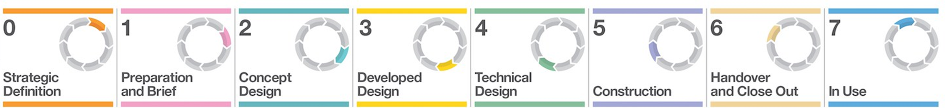

Workshop1 – Stakeholder relationships
The RIBA plan of work provides a useful description of the construction process. However, one key message is that stakeholders need to be brought together, as early as possible to ensure efficiency in the construction process
Task – define who the key stakeholders and their role in the process
Circular Economy
and the Construction Sector
Notes:
Design quickly leads into communication and engagement by the key stakeholders. We have already seen in Session 2 that the RIBA plan of work progresses through time but the earliest engagement of all stakeholders and effective communication can only work to the benefit of waste reduction.
But first in your groups, discuss who the key stakeholders are in the build process.
So the group should identify the following as the principal stakeholders:
Clients
Designers or architects
Main contractor
Possibly subcontractors
And one final stakeholder is the waste management company who can provide a waste recycling and recovery service onsite or offsite
Make sure the group understands who these stakeholders are and what their role is.

Slide 10
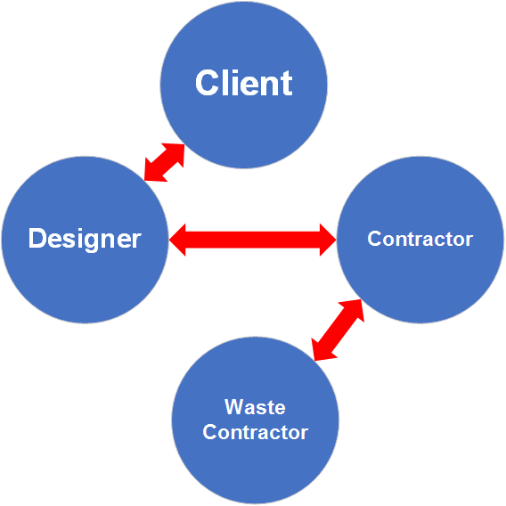
Workshop1 – Stakeholder relationships
We have already suggested that each stakeholder should be engaged in the project as early as possible
Task – Each person in your group should assume the role of the client/ designer/ contractor/ waste management company and offer to the group one idea that would improve waste reduction
Circular Economy
and the Construction Sector

Slide 11

Opportunities
Design
Standardisation of design to reduce offcuts
Materials selection
Consider whole life cycle of building
Procurement
Supply chain relationships
Off-site prefabrication
Specialist waste contract package
Contractual clause to reward/penalise waste management practices
Notes:
The kinds of improvement opportunities that the group came up with are likely to be those on the next two slides.
Design remains an important area- standardisation of sizes to avoid off-cuts. Choose materials that have recycled content or durable or can be reused, and conside the opportunity to extend the life of the building or indeed design to make it easier to dismantle.
Procuring services and building products creates another opportunity, which mainly lies with the contractor. Establish a relationship that can include take-back of surplus material, identify if components can be build as pre-fabricated. Selection f waste contractors who can support waste segregation and have the necessary facilities to avoid disposal to landfill but reuse or recycle waste material collected on site.

Slide 12

Opportunities
On-site Management
Good stock control – avoid over-ordering
Just in time delivery
Provision of material waste skips - segregated
Supplier flexibility with smaller quantities
Site waste management plan (SWMP) and audits
Across the project
Better communication
Improved education and training
Notes:
A clean and tidy site is a sign that materials management is a priority. Good stock control helps avoid left-over material and together with materials being delivered when required helps avoid material damage and wastage on site.
A supplier who can deliver materials in the right quantity can help this.
An area set aside for waste segregation skips and ensuring their proper use is important
Significantly, everyone knowing what is expected of them is key and may require some degree of training as part of onsite induction

Slide 13
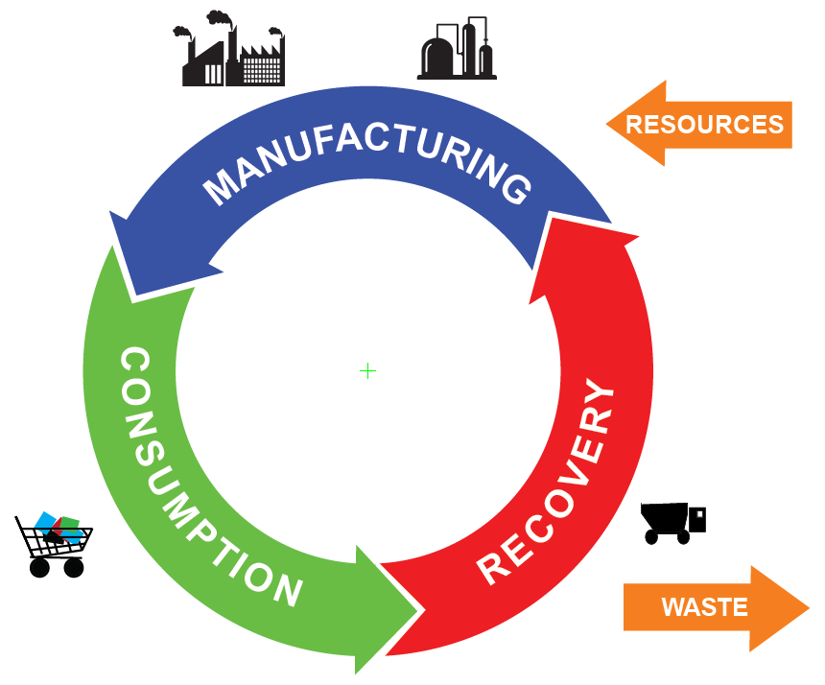
Conclusion
Implementing a waste hierarchy – or reduce, reuse, recycle – approach is a useful way to prioritise waste reduction and avoid landfilling of construction waste
Opportunities exist at many stages in the build process – but perhaps most significantly at the design stage
Design, procurement, onsite management and education of workforce all contribute to effective waste management

